Slide 1
Chapter 2. Introducing the UML
Chapter 2
The Unified Modeling Language User Guide
SECOND EDITION
By Grady Booch, James Rumbaugh, Ivar Jacobson

Slide 2
What is UML?
Unified Modeling Language
OMG Standard, Object Management Group Based on work from Booch, Rumbaugh, Jacobson
UML is a modeling language to express and design documents, software:
Particularly useful for OO design
Not a process
Independent of implementation language
Latest Version 2.5.1 (December 2017) - http://www.uml.org/

Slide 3
Why use UML
Standardized graphical notation for
Specifying
Visualizing
Constructing and
Documenting software systems
Language can be used from general initial design to very specific detailed design
Increase understanding/communication of product to customers and developers
Support for UML in many software packages today (e.g. Rational)

Slide 4
The UML is a language for Visualizing
Some things are best modeled textually; others graphically
The UML is more than just a bunch of graphical symbols
One developer can write a model in the UML, and another developer, or even another tool, can interpret that model unambiguously

Slide 5
The UML is a language for Specifying
Specifying means building models that are precise, unambiguous, and complete
In particular, the UML addresses the specification of all the important analysis, design, and implementation decisions that must be made in developing and deploying a software-intensive system.

Slide 6
The UML is a language for Constructing
UML is not a visual programming language, but its models can be directly connected to a variety of programming languages
It is possible to map from a model in the UML to a programming language such as Java, C++, or VB, or even to tables in a RDBMS

Slide 7
The UML is a language for Documenting
The UML addresses the documentation of a system’s architecture and all of its details
The UML also provides a language for expressing requirements and for tests
Finally, the UML provides a language for modeling the activities of project planning and release management

Slide 8
Building blocks of the UML
The vocabulary of the UML encompasses three kinds of building blocks:
Things - abstractions that are first-class citizens in a model
Relationships - tie these things together
Diagrams - group interesting collections of things

Slide 9
Things in the UML
Structural things
Behavioral things
Grouping things
Annotation things

Slide 10
Structural things
Structural things are the nouns of the UML model. These are the mostly static parts of a model, representing elements that are either conceptual or physical. There are eight kinds of structural things.

Slide 11

Structural thing - Class
A class is a description of set of objects that share the same attributes, operations, relationships, and semantics.

Slide 12
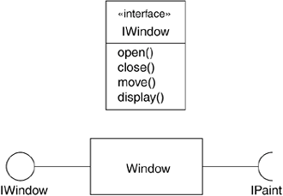
Structural thing - Interface
An interface is a collection of operations that specify a service of a class or component. An interface therefore describes the externally visible behavior of that element
<<Stereotype>> - Role

Slide 13
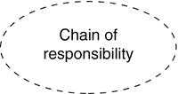
Structural thing - Collaboration
A collaboration defines an interaction and is a society of roles and other elements that work together to provide some cooperative behavior that’s bigger than the sum of all the elements

Slide 14
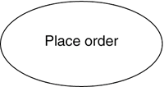
Structural thing- Use Case
A Use case is a description of set of sequence of actions that a system performs that yields an observable result of value to a particular actor.

Slide 15
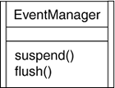
Structural thing- Active Class
An active class is a class whose objects own one or more processes or threads and therefore can initiate control activity. An active class is just like a class except that its objects represent elements whose behavior is concurrent with other elements.

Slide 16

Structural thing- Component
A component is a physical and replaceable part of a system that conforms to and provides the realization of a set of interfaces.

Slide 17

Structural thing- Artifact
An artifact is a physical and replaceable part of a system that contains physical information ("bits").

Slide 18
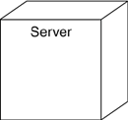
Structural thing- Node
A node is a physical element that exists at run time and represents a computational resource, generally having at least some memory and often, processing capability.

Slide 19
Behavioral Things
Behavioral things are the dynamic parts of UML models. These are the verbs of a model, representing behavior over time and space. There are three kinds of behavioral things

Slide 20
Behavioral Thing- Interaction
An interaction is a behavior that comprises a set of messages exchanged among a set of objects within a particular context to accomplish a specific purpose.

Slide 21

Behavioral Thing- State Machine
A state machine is a behavior that specifies the sequences of states an object or an interaction goes through during its lifetime in response to events.

Slide 22

Behavioral Thing- Activity
An activity is a behavior that specifies the sequence of steps a computational process performs.

Slide 23
Comparison among Behavioral Things
Comparison:
In an interaction, the focus is on the set of objects that interact.
In a state machine, the focus is on the life cycle of one object at a time.
In an activity, the focus is on the flows among steps without regard to which object performs each step.
A step of an activity is called an action.

Slide 24
Grouping Things
Grouping things are the organizational parts of UML models. These are the boxes into which a model can be decomposed. There is one primary kind of grouping thing, namely, packages.
There are also variations, such as frameworks, models, and subsystems (kinds of packages).

Slide 25
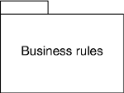
Grouping Thing- Package
A package is a general-purpose mechanism for organizing elements into groups. Structural things, behavioral things, and even other grouping things can be placed in a package. Unlike components (which exists at runtime), a package is purely conceptual (meaning that it only exists at development time).

Slide 26

Annotational Things Note
Annotational things are the explanatory parts of UML models. These are the comments you may apply to describe, illuminate, and remark about any element in a model.
There is one primary kind of annotational thing, called a note. A note is simply a symbol for rendering constraints and comments attached to an element or a collection of elements.

Slide 27
Relationships in the UML
There are four kinds of relationships in the UML:
Dependency
Association
Generalization
Realization

Slide 28
Relationship - Dependency
A dependency is a semantic relationship between two things in which a change to one (the independent thing) may effect the semantics of the other thing (the dependent thing).

Slide 29

Relationship - Association
An Association is a structural relationship that describes a set of links. A link is a connection among objects.

Slide 30
Relationship - Generalization
A generalization is a specialization/ generalization relationship in which objects of the specialized element (the child) and substitutable for objects of the generalized element (the parent). In this way, the child shares the structure and behavior of the parent.

Slide 31
Relationship - Realization
A realization is a semantic relationship between classifiers, wherein one classifier specifies a contract that another classifier guarantees to carry out.

Slide 32
Diagrams in the UML
A diagram is the graphical presentation of a set of elements, most often rendered as a connected graph of vertices (things) and arcs (relationships). The UML includes 14 such diagrams.

Slide 33
Diagrams in the UML
Class diagram (Static Design or Process View)
Object diagram (Static Design or Process View)
Component diagram (Static Design Implementation View)
Composite structure diagram (Hybrid)
Use case diagram (Static Use Case View)
Sequence diagram (Dynamic Interaction View with Time Ordering)
Communication diagram (Dynamic Interaction View with structure)
State diagram (Dynamic Behavioral View of object)
Activity diagram (Dynamic Process View)
Deployment diagram (Static Deployment View)
Artifact diagram (Static Implementation view)
Package diagram (Static View)
Timing diagram (Dynamic view with specific time)
Interaction overview diagram (Hybrid)

Slide 34
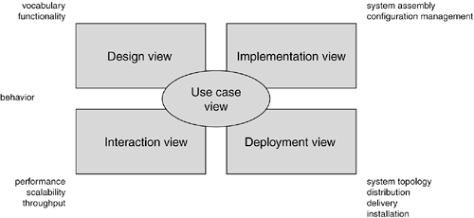
Modeling a System's Architecture

Slide 35
Evolution of Software Development Methodologies

Slide 36
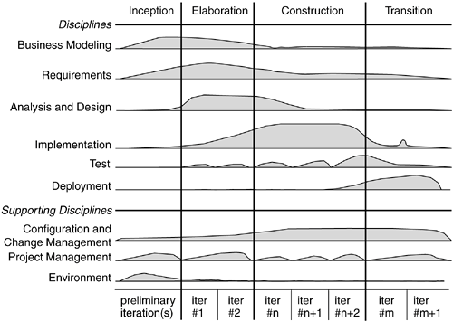
Software Development Life Cycle – Rational Unified Process (RUP)

Slide 37
Software Development Life Cycle
Inception is the first phase of the process, when the seed idea for the development is brought up to the point of being at least internally sufficiently well-founded to warrant entering into the elaboration phase.
Elaboration is the second phase of the process, when the product requirements and architecture are defined. In this phase, the requirements are articulated, prioritized, and baselined. A system's requirements may range from general vision statements to precise evaluation criteria, each specifying particular functional or nonfunctional behavior and each providing a basis for testing.
Construction is the third phase of the process, when the software is brought from an executable architectural baseline to being ready to be transitioned to the user community. Here also, the system's requirements and especially its evaluation criteria are constantly reexamined against the business needs of the project, and resources are allocated as appropriate to actively attack risks to the project.
Transition is the fourth phase of the process, when the software is delivered to the user community. Rarely does the software development process end here, for even during this phase, the system is continuously improved, bugs are eradicated, and features that didn't make an earlier release are added.
An iteration is a distinct set of work tasks, with a baselined plan and evaluation criteria that results in an executable system that can be run, tested, and evaluated.

